Slide 1
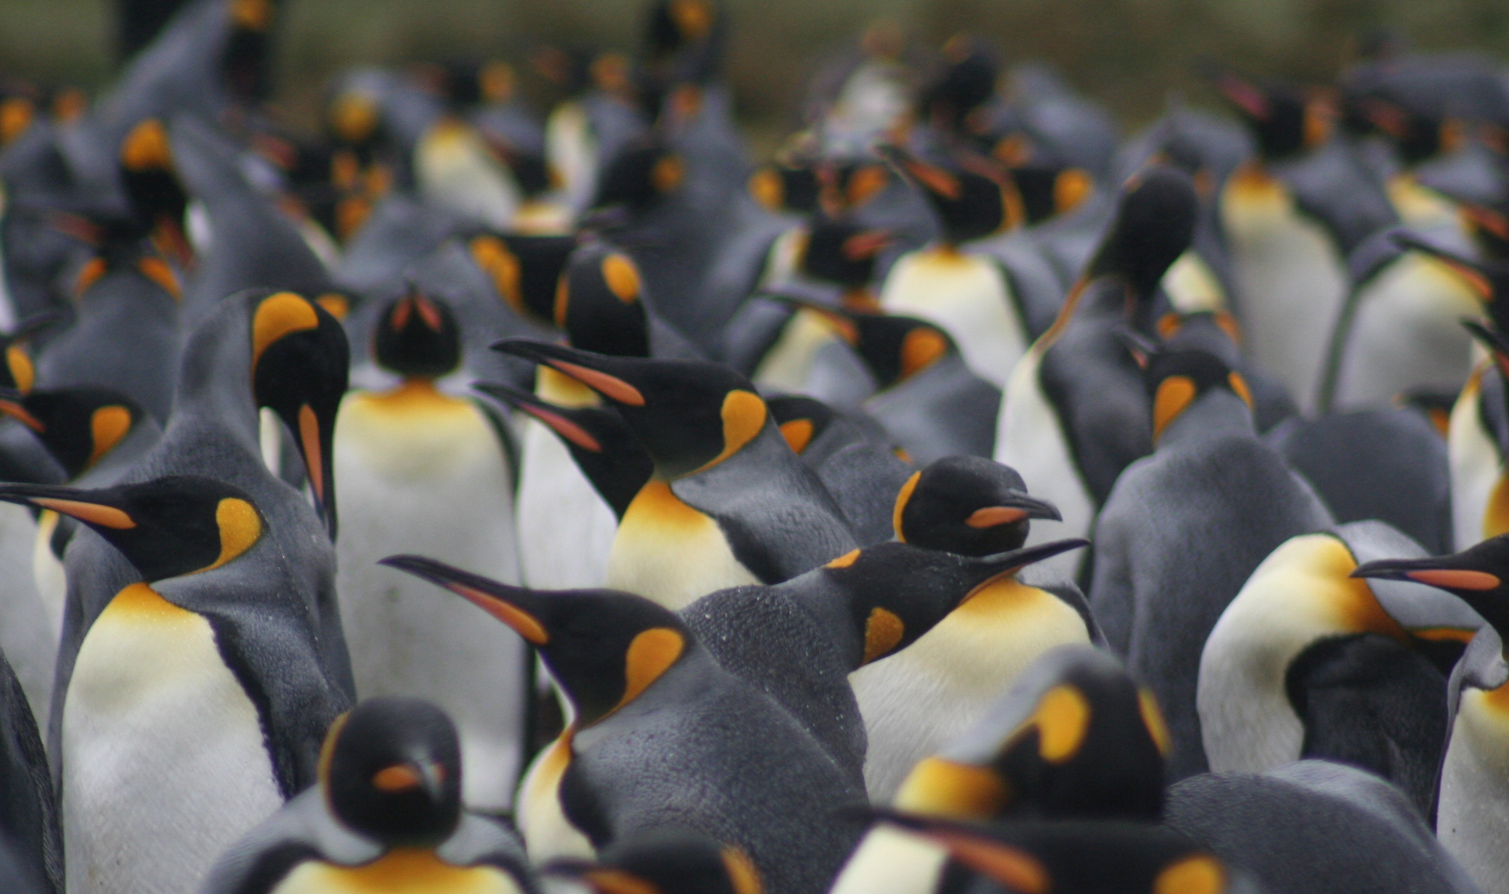
1) Optimal foraging under predation risk

Slide 2
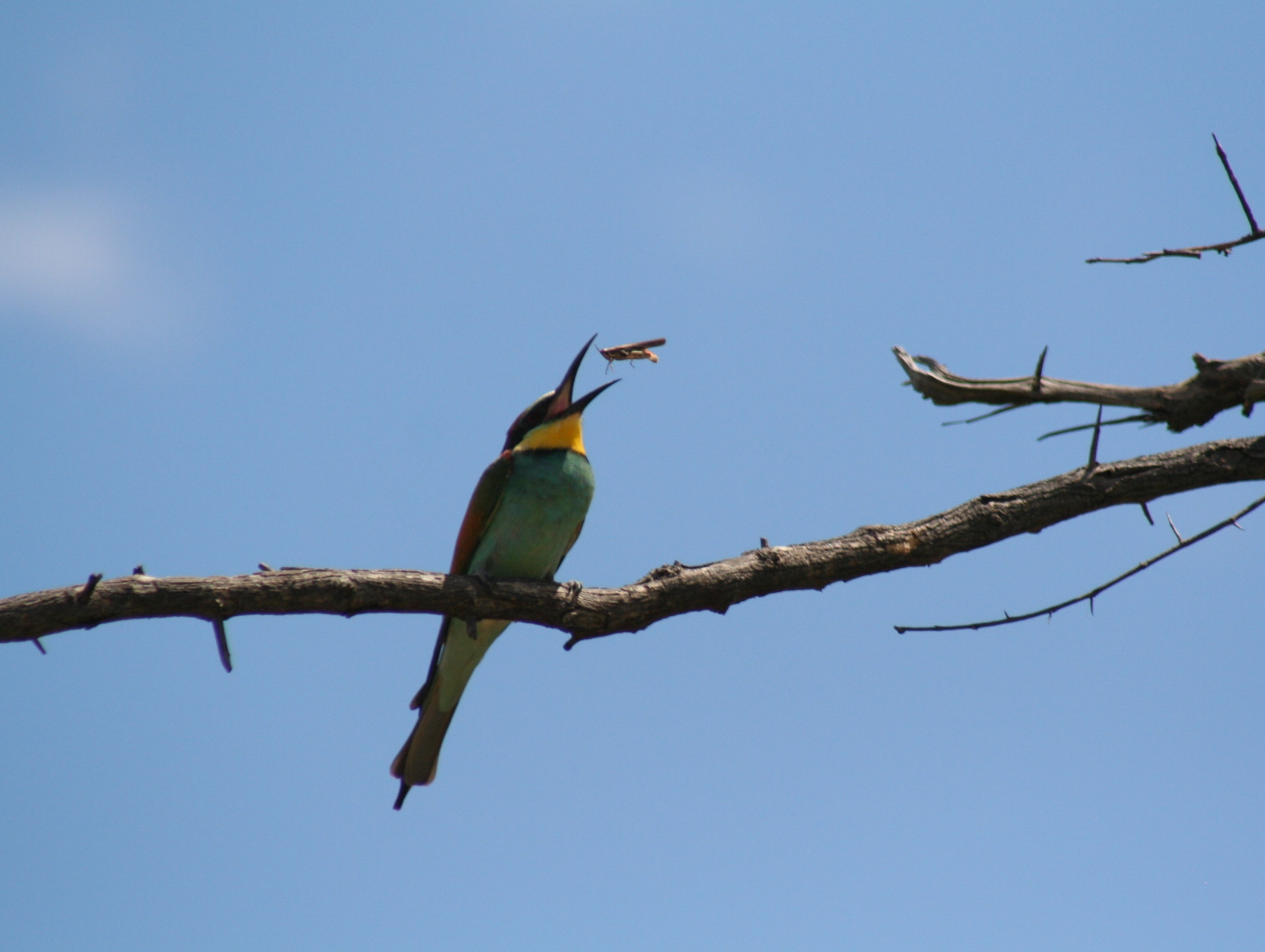
Basic assumption of optimal foraging theory:
Assumes that natural selection has resulted in foraging behavior that maximizes fitness
(Houston & McNamara 2014, J. Anim. Ecol.)

Slide 3
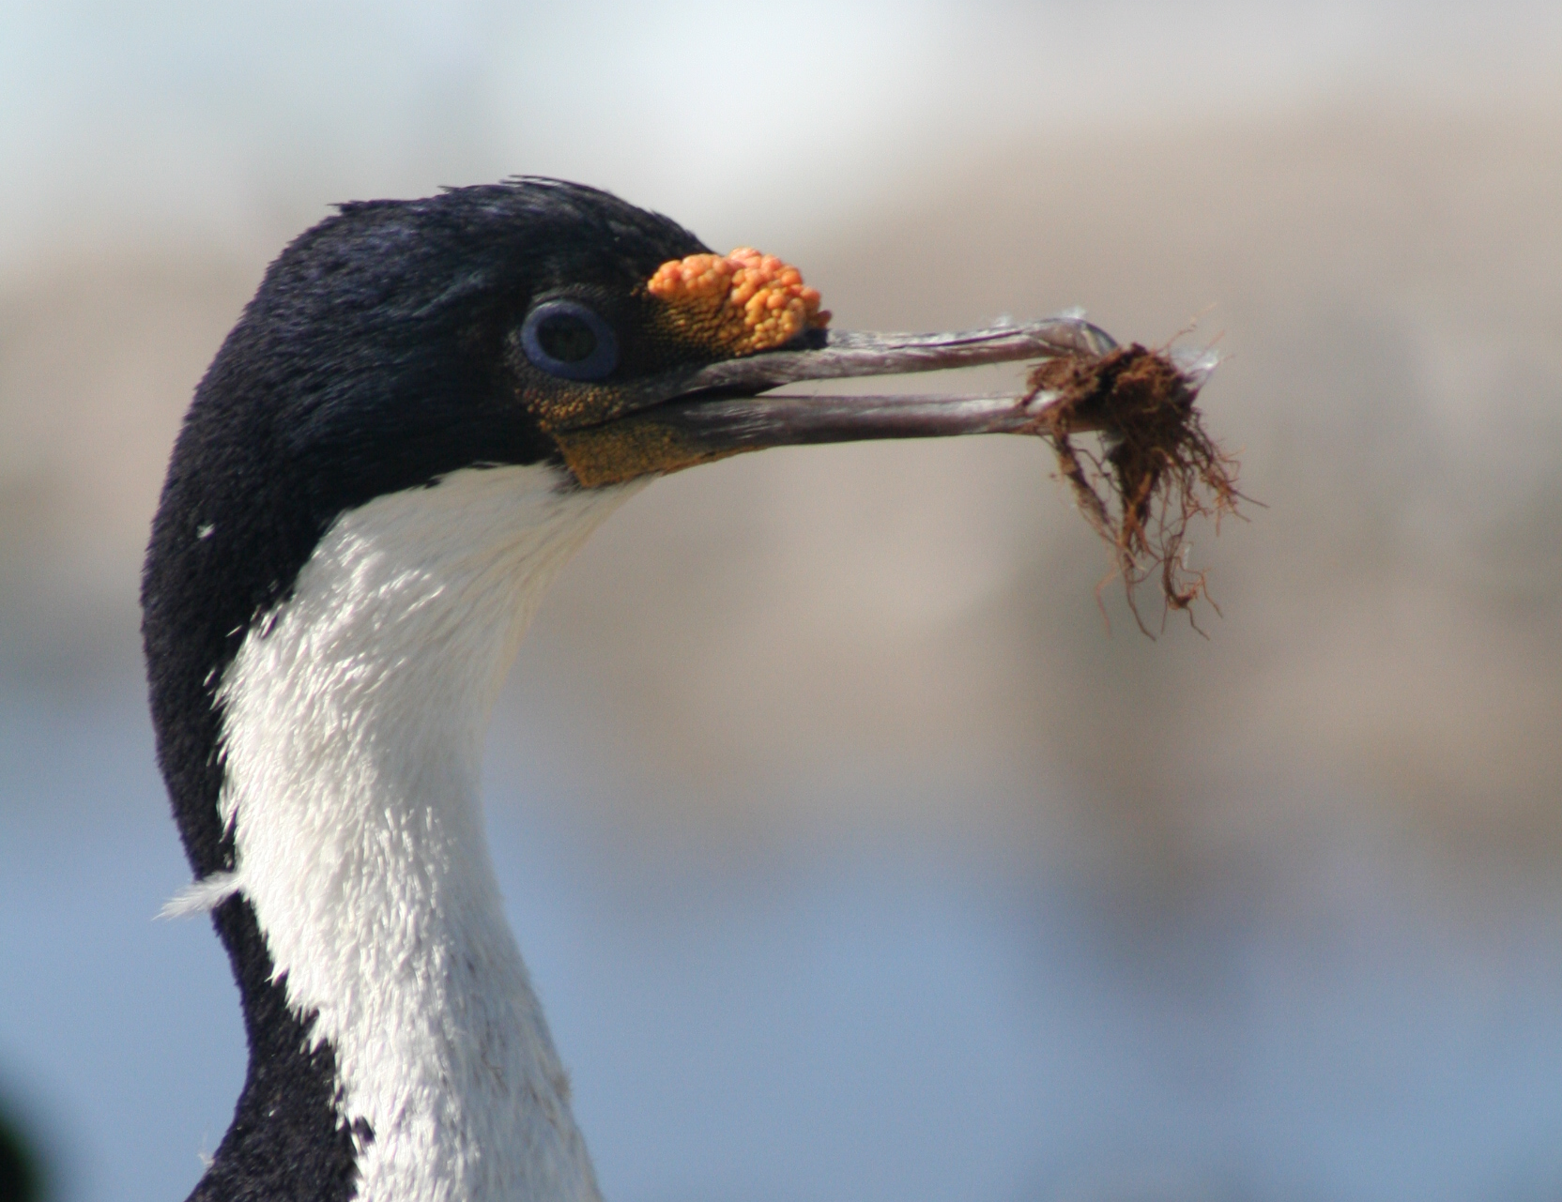
Basic elements optimality models
Choose the option maximizing a currency, given the constraints
Among the most influential models:
Marginal value theorem: how long to forage in patch (Charnov 1976)
Contingency model of optimal diet: what should be consumed (MacArthur & Pianka 1966)

Slide 4
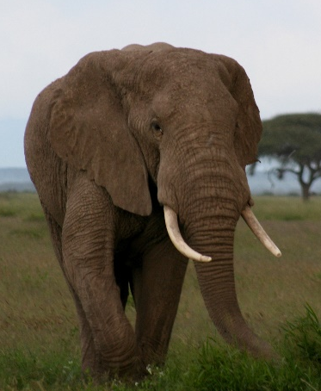
Optimal patch departure time
Marginal value theorem
Charnov, E.L. 1976. Optimal foraging: the marginal value theorem.
Theoretical Population Biology 9:129-136.
Cumulative gain rate, g(t)
g(t)
S + t
R(t) =
-10 -5 0 5 10 15 20
Travel time, S
Foraging time in the patch, t
Notes:
Probably the most influencial functional response – been wildely use to model carnivore-herbivore relationship

Slide 5
Optimal patch departure time
Marginal value theorem
Charnov, E.L. 1976. Optimal foraging: the marginal value theorem.
Theoretical Population Biology 9:129-136.
Cumulative gain rate, g(t)
Optimal residence time
-S
t*
-10 -5 0 5 10 15 20
Travel time, S
Foraging time in the patch, t
Notes:
Probably the most influencial functional response – been wildely use to model carnivore-herbivore relationship

Slide 6
Optimal patch departure time
Marginal value theorem
Lower average time to move between patches
Cumulative gain rate, g(t)
-S
t*
-10 -5 0 5 10 15 20
Travel time, S
Foraging time in the patch, t
Notes:
Probably the most influencial functional response – been wildely use to model carnivore-herbivore relationship

Slide 7
Optimal patch departure time
Marginal value theorem
Lower performance of the consumer
-S
t*
-10 -5 0 5 10 15 20
Travel time, S
Foraging time in the patch, t
Notes:
Probably the most influencial functional response – been wildely use to model carnivore-herbivore relationship

Slide 8

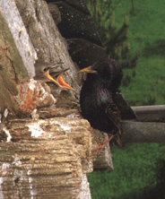
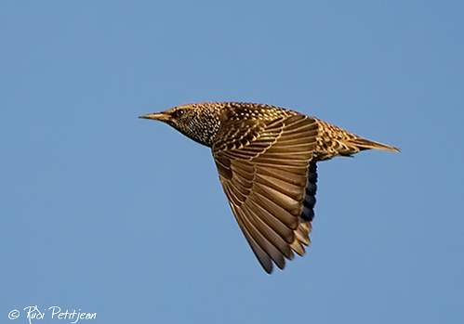
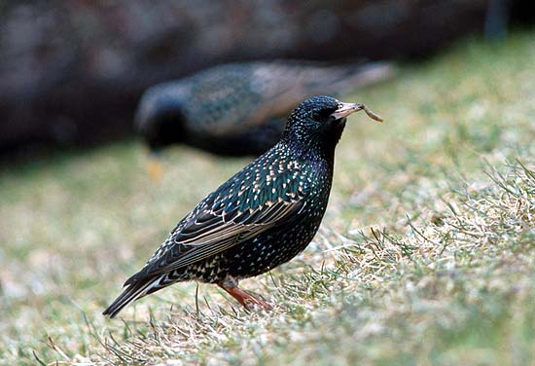
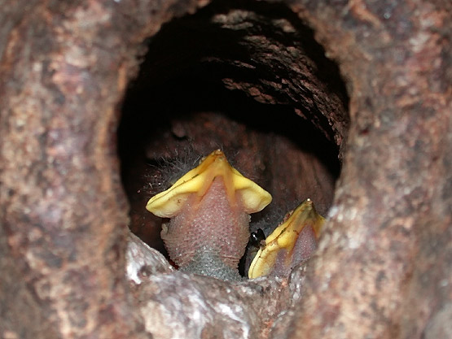
Optimal patch departure time
Marginal value theorem
Mealworms (larvae of Tenebrio molitor)
Variation in mealworm load size, given the distance from the nest
Kacelnik (1984, Journal of Animal Ecology 53: 283-299)
Notes:
Probably the most influencial functional response – been wildely use to model carnivore-herbivore relationship

Slide 9
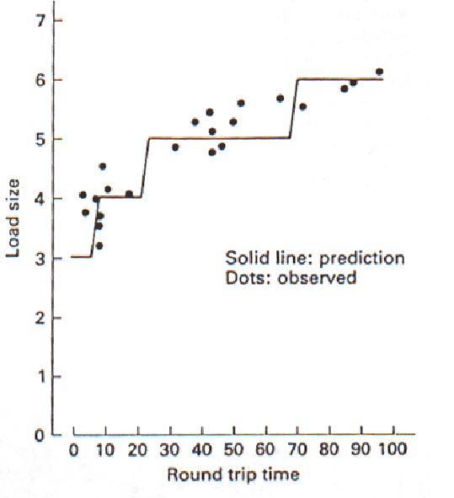

Optimal patch departure time
Marginal value theorem
Place feeding trays with mealworms at different distances from the nest
Induce a decrease in worm capture rate with time spent in the patch; he manipulated the gain function
How should load size vary with the distance from the nest
Model predicts larger loads with longer travel times
Kacelnik (1984, J. Anim. Ecol. 53: 283-299)
Notes:
Probably the most influencial functional response – been wildely use to model carnivore-herbivore relationship

Slide 10

Optimal diet choice: the contingency model
MacArthur RH, Pianka ER (1966) On the optimal use of a patchy environment. American Naturalist 100 (916): 603–9

Slide 11
Estimation of the rate of energy intake
F
E =
e
= e I
T_{f}
E: Energy intake rate (kJ / min), F: Number of prey consumed (prey),
T_{f}: Total foraging time (min), e: Energy content (kJ / prey)
F / T_{f} = I = Prey intake rate (prey / min)
Energy intake rate = (Intake rate of a given prey type) x (energy content)
Related to functional responses
Notes:
Ask them

Slide 12
Main types of functional response
I
III
II
Resource intake rate (resource/min)
Resource density (resources / m²)

Slide 13
Mechanistic functional response
F
aNT_{s}
I
I =
=
T_{f}
T_{s} + T_{h}
T_{f} = T_{s} + T_{h}
a: Search rate, e.g., area over which prey can detect per unit of time (m²/min)
Speed (m /min) x detection radius (m)
N: Resource density (resources / m²)
T_{s}: Total time spent searching (min) during T_{f}
T_{h}: Total time species handling (min) during T_{f}
Notes:
Probably the most influencial functional response – been wildely use to model carnivore-herbivore relationship

Slide 14
Mechanistic functional response
F
aNT_{s}
I
I =
=
T_{f}
T_{s} + aNT_{s}×h
T_{f} = T_{s} + T_{h}
a: Search rate, e.g., area over which prey can detect per unit of time (m²/min)
Speed (m /min) x detection radius (m)
N: prey density (prey/ m²)
T_{s}: Total time spent searching (min) during T_{f}
T_{h}: Total time species handling (min) during T_{f}
T_{h} = aNT_{s} x h,
where h: time needed to handle each prey (min / prey)
Notes:
Probably the most influencial functional response – been wildely use to model carnivore-herbivore relationship

Slide 15
Multispecies mechanistic functional response
Mechanistic functional response
aNT_{s}
aNT_{s}
I
=
I
=
T_{s} + aNT_{s}×h
T_{s} + aNT_{s}×h
M
i=1
M
i=1
Σ
Σ
aT_{s} (N_{i}p_{i})
a (N_{i}p_{i})
I
=
=
M
i=1
M
i=1
Σ
Σ
T_{s} + aT_{s} (N_{i}h_{i}p_{i})
1 + a (N_{i}h_{i}p_{i})
Where p_{i} indicates whether (value of 1) are not (value of 0) type i prey is consumed whenever encountered
What if multiple prey types can be consumed?
Notes:
Probably the most influencial functional response – been wildely use to model carnivore-herbivore relationship

Slide 16
Maximization of energy intake rate:
the contingency model
M
i=1
M
i=1
Σ
Σ
aT_{s} (N_{i}p_{i})
a (N_{i}p_{i})
I
=
=
M
i=1
M
i=1
Σ
Σ
T_{s} + aT_{s} (N_{i}h_{i}p_{i})
1 + a (N_{i}h_{i}p_{i})
We can estimate E for a diet of M resource types by multiplying e of each resource type following:
M
i=1
Σ
a (N_{i}p_{i}e_{i})
E
=
M
i=1
Σ
1 + a (N_{i}h_{i}p_{i})
Notes:
Probably the most influencial functional response – been wildely use to model carnivore-herbivore relationship

Slide 17
Maximization of energy intake rate:
the contingency model
M
i=1
Σ
a (N_{i}p_{i}e_{i})
E_{total}
=
M
i=1
Σ
1 + a (N_{i}h_{i}p_{i})
Let’s evaluate a diet comprised of two resource types:
a(N₁p₁e₁ + N₂p₂e₂)
E_{total}
=
1 +a(N₁h₁p₁ + N₂h₂p₂)
We can assume that the profitability of type 1 resource is higher than that for type 2 resource, i.e., e₁/h₁ > e₂/h₂. Which diet would then yield the maximum energy gain?
Notes:
Probably the most influencial functional response – been wildely use to model carnivore-herbivore relationship

Slide 18
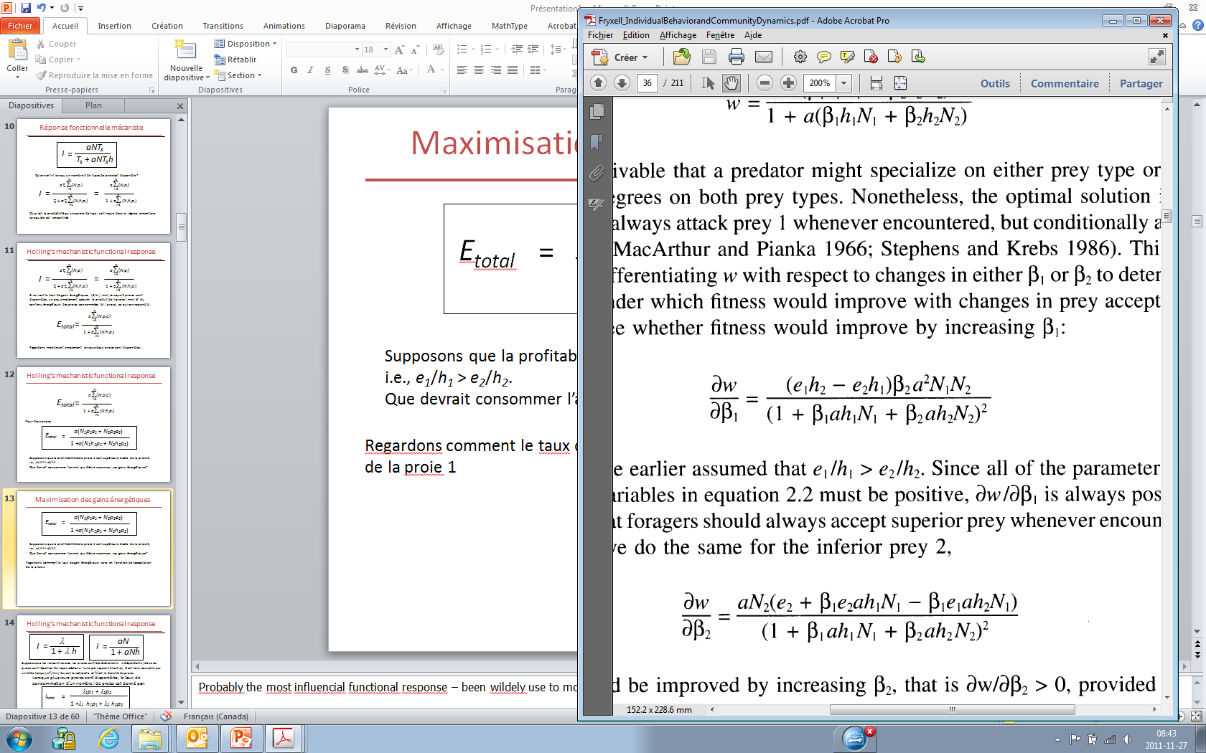
Maximization of energy intake rate:
the contingency model
a(N₁p₁e₁ + N₂p₂e₂)
E
=
1 +a(N₁h₁p₁ + N₂h₂p₂)
Let’s now evaluate how energy intake rate varies with the consumption of type 1 resource:
E
p₂
p₁
p₁
p₂
∂E
Because e₁/h₁ > e₂/h₂, can only be positive…
∂ p₁
… type 1 resource should therefore
always be consumed to maximize E

Slide 19
Maximization of energy intake rate:
the contingency model
a(N₁p₁e₁ + N₂p₂e₂)
E
=
1 +a(N₁h₁p₁ + N₂h₂p₂)
We can evaluate how energy intake rate varies with the consumption of type 2 resource :
∂E
p₁
p₁
=
∂ p₂
p₁
p₂
λ₁
∂E
Consuming type 2 resource increase energy gains (i.e., > 0) when…
∂ p₂
e₂
e₁h₂ - e₂h₁
Type 2 resource should not be consumed if the abundance of type 1 resource is relatively high
Encounter rate
N₁a <
Notes:
Probably the most influencial functional response – been wildely use to model carnivore-herbivore relationship

Slide 20
Maximization of energy intake rate:
the contingenty model
Energy gain rate
(kJ/min)
Decreasing profitability (kJ/min)
Change in energy gain rate following the successive addition of resource types in the diet, in order of decreasing profitability
5
i=1
Σ
a (N_{i}e_{i})
>
e₆
> …
>
e₁₀
E =
5
i=1
h₆
Σ
h₁₀
1 + a (N_{i}h_{i})

Slide 21
Maximization of energy intake rate:
the contingenty model
Optimal choice depends on the encounter rate with the optimal resource types
Change in the availability of the less profitable types does not influence the optimal diet
Associated with the principle of missed opportunity costs
A given resource type should always be consumed or ignored encountered, i.e., 0-1 rule

Slide 22
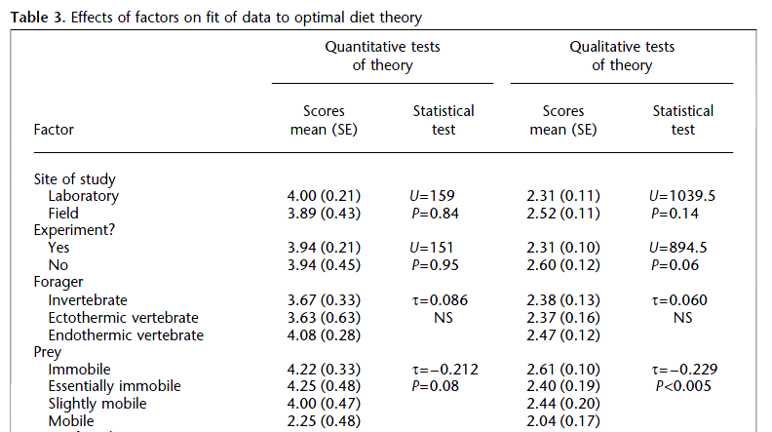
Maximization of energy intake rate:
the contingenty model
Échelle: 1-6*
Échelle: 1-3*
*Higher scores indicate higher support to optimal diet theory.
Sih et Christensen 2001, Anim. Behav. 61: 379-390

Slide 23
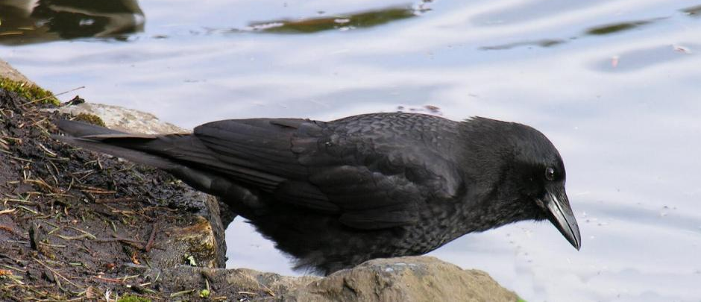
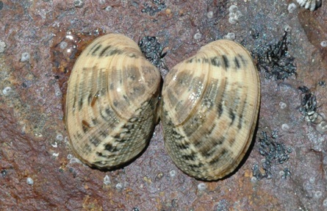
Maximization of energy intake rate:
the contingenty model
Northwester crows feeding on littleneck clams
Must find, then open the clams by dropping them on flat rock
(Corvus caurinus)
(Venerupis japonica)
Richardson and Verbeek (1986,
Ecology 67: 1219-26)

Slide 24
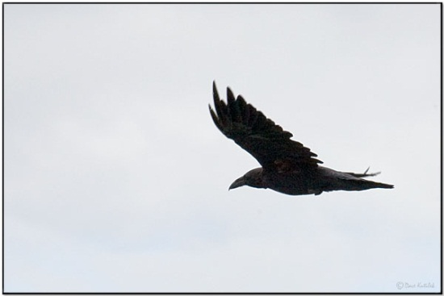
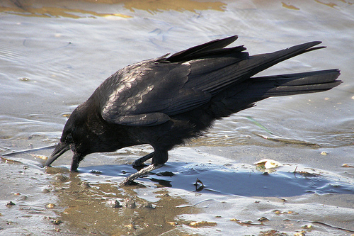
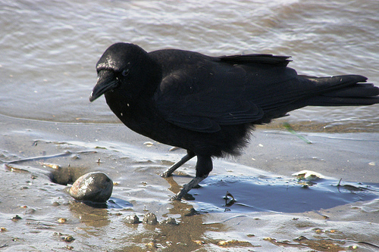
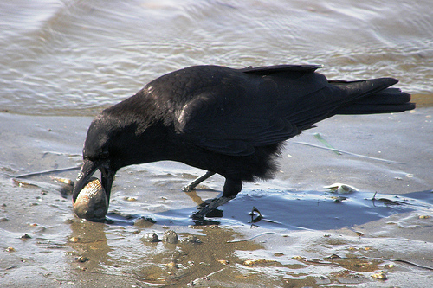
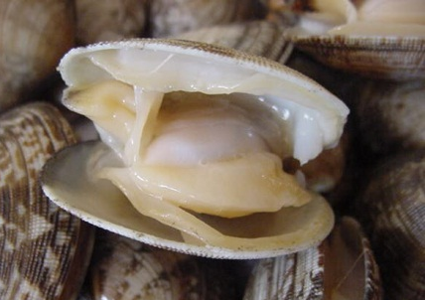
Maximization of energy intake rate:
the contingenty model
34.6 sec to find a clam
4.2 sec first drop flight
5.5 sec handling between drops
Flight costs > 4x higher than search and dig costs
Richardson and Verbeek (1986, Ecology 67: 1219-26)

Slide 25
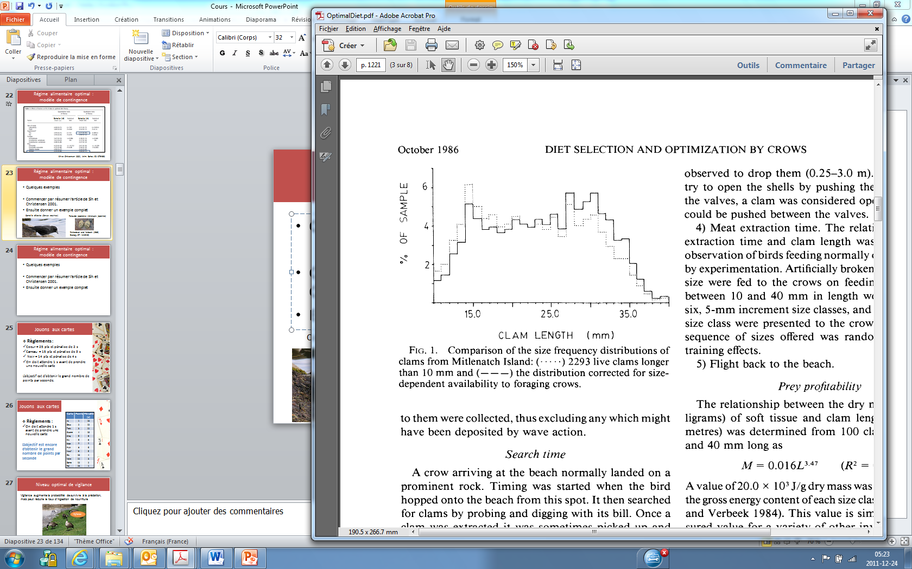
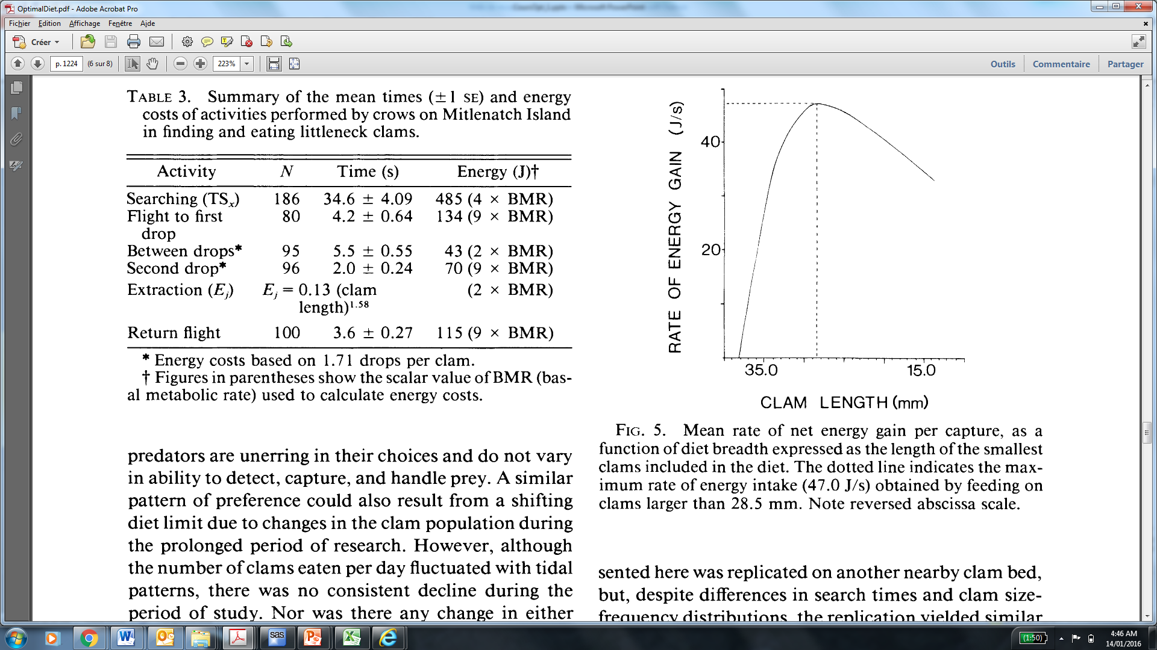
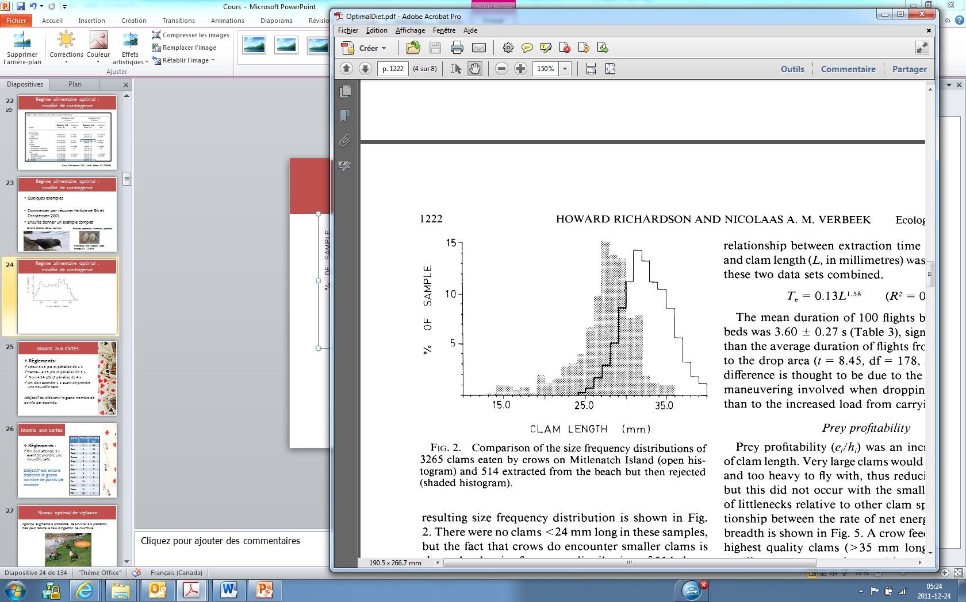
Maximization of energy intake rate:
the contingenty model
Availability
Should be
consumed
Consumed
Rejected
Clam length (mm)
Notice: Inversed scale

Slide 26
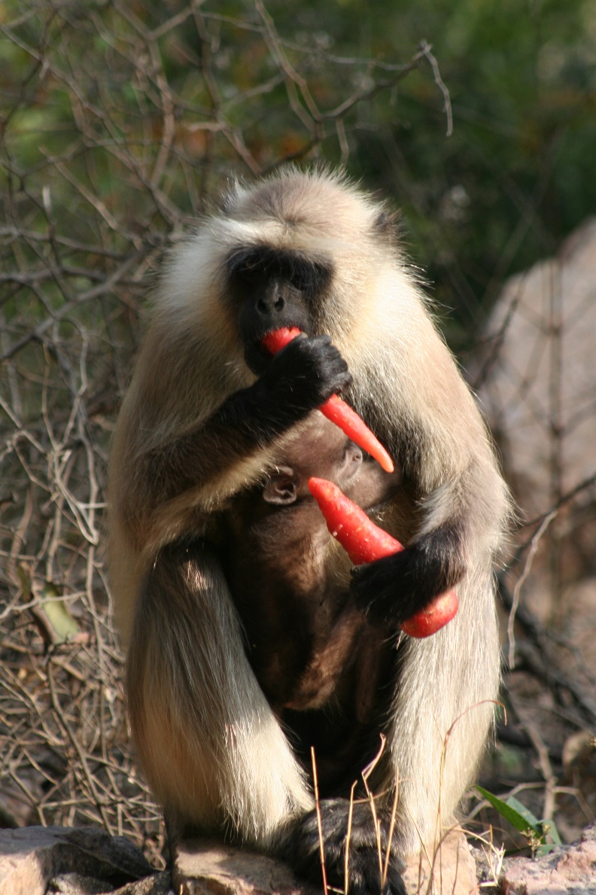
Maximization of energy intake rate:
the contingenty model
Some assumptions of the contingency model:
Omniscience
Successive encounters with resources are independent events (e.g., not distributed in patches)
No predation

Slide 27
Maximization of energy intake rate:
the contingenty model
Some assumptions of the contingency model:
Omniscience
Successive encounters with resource are independent events (e.g., not distributed in patches)
No predation

Slide 28

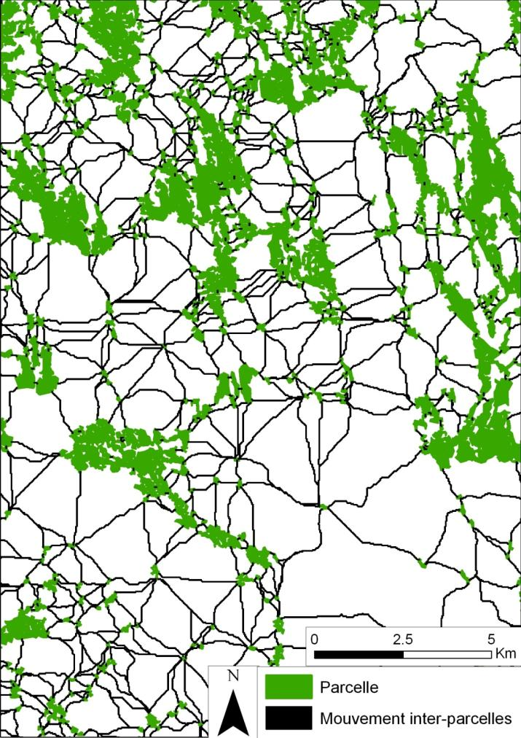
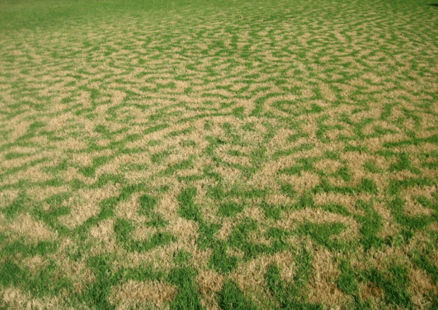
What if prey forage in a mosaic of food patches in which > 1 resource type is available?
© R. Du Toit

Slide 29

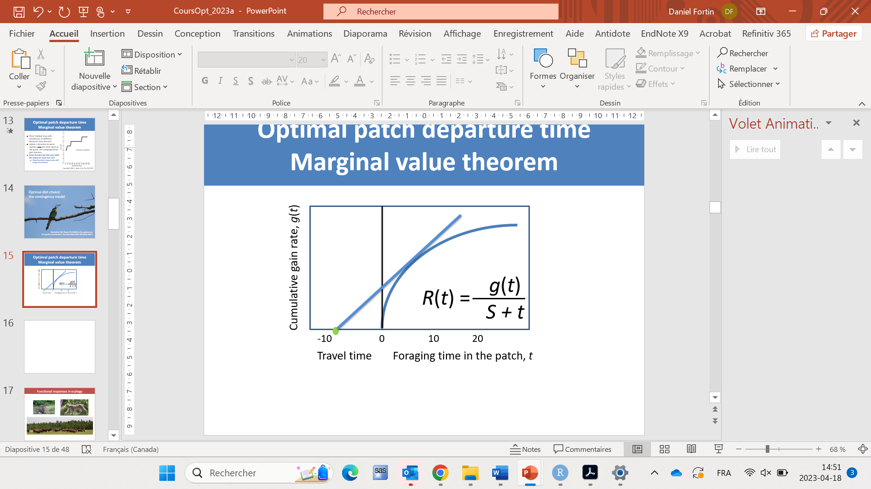


What if prey forage in a mosaic of food patches in which > 1 resource type is available?
t*
S
Marginal value theorem
Contingency model
t*
g(t*) depends on food choice
Should leave when: t* = – S + g(t*)
R(t*)
Find g(t*) given E*
When to leave the patch
© R. Du Toit
What to eat in the patch

Slide 30
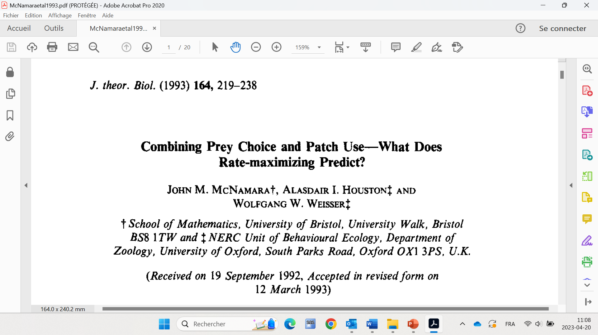
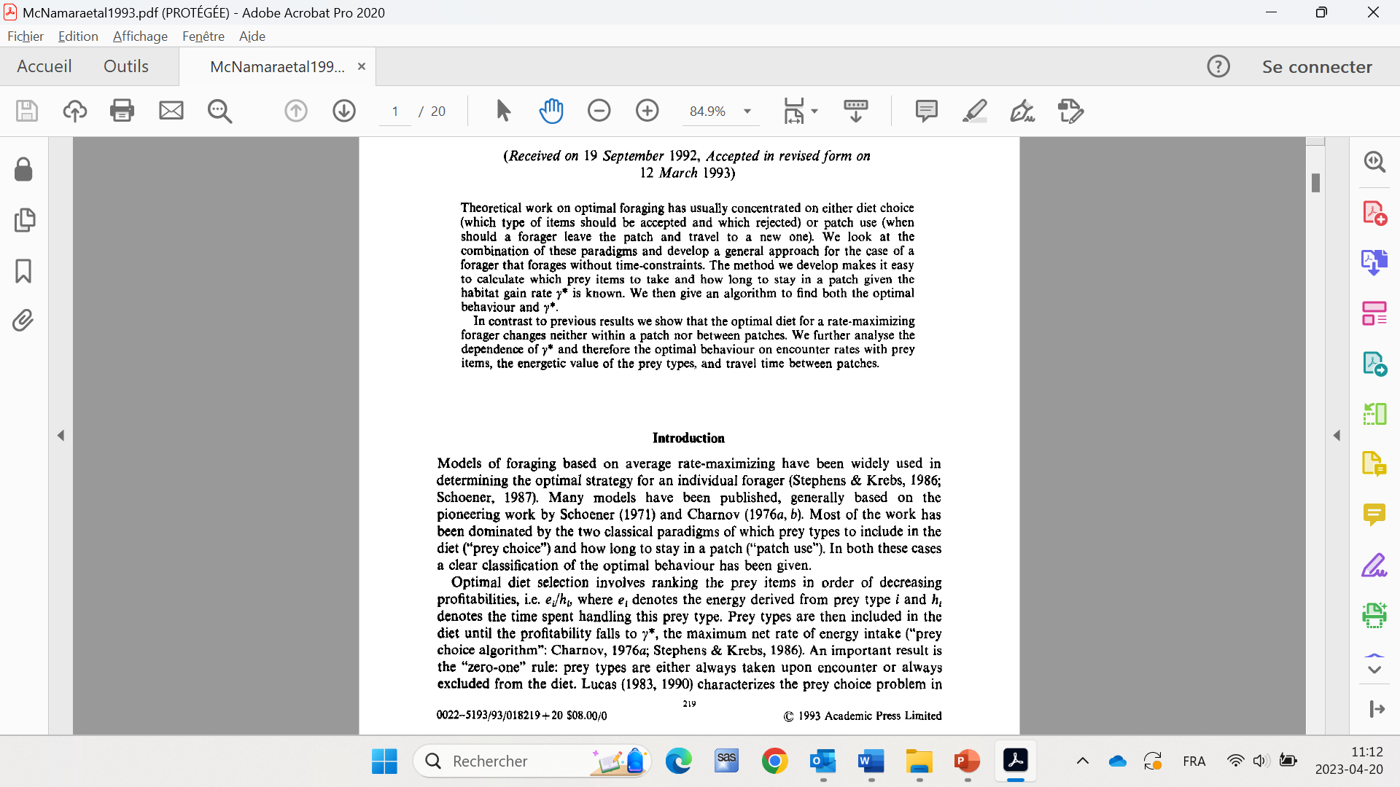
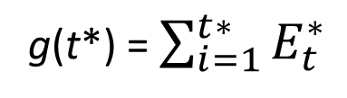
What if prey forage in a mosaic of food patches in which > 1 resource type is available?
t*
S
Marginal value theorem
Contingency model
…
t*
g(t*) = $\sum_{i=1}^{t∗}{E_{t}^{∗}}$

Slide 31
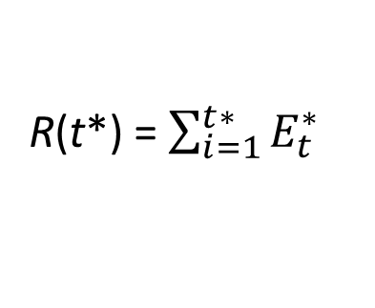
What if prey forage in a mosaic of food patches in which > 1 resource type is available?
t*
S
Marginal value theorem
Contingency model
t*
g(t*)
g(t*) = $\sum_{i=1}^{t∗}{E_{t}^{∗}}$
R(t*) = $\sum_{i=1}^{t∗}{E_{t}^{∗}}$
R(t*) =
S + t*
S + t*
When to leave the patch
© R. Du Toit
What to eat in the patch

Slide 32
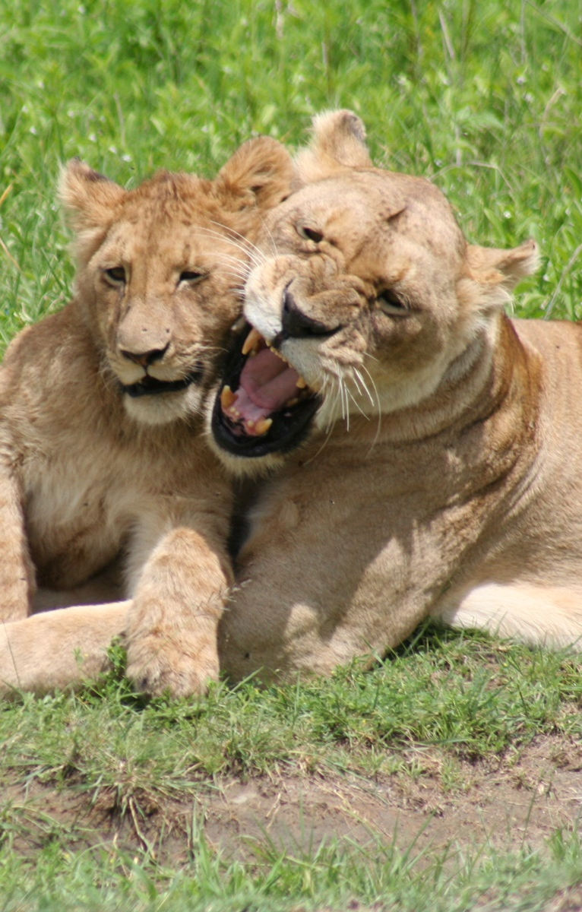
Maximization of energy intake rate:
the contingenty model
Some assumptions of the contingency model:
Omniscience
Successive encounters with resource are independent events (e.g., not distributed in patches)
No predation

Slide 33
What if a predator enters the system, and prey have access to refuges?
Refuge
t
S
R(t) =
T_{s} aN g(t)
R(t) =
T_{s} aN g(t)
aN g(t)
=
T_{s} + T_{h} + T_{r}
T_{f}
T_{s} + aNT_{s}t + T_{r}
1 + aNt + T_{r} /T_{s}
T_{s}: total time spent searching (min)
T_{h}: total time foraging in paches (min)
T_{r}: total time spent in refuges (min)
aN = λ: patch encounter rate (patches/min)

Slide 34
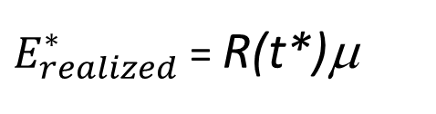
What if a predator enters the system, and prey have access to refuges?
Refuge
t
S
R(t) =
aN g(t)
μ = T_{s}μ_{s} + T_{h}μ_{h} + T_{r}μ_{r}
1 + aNt + T_{r} /T_{s}
T_{s} + T_{h} + T_{r}
$E_{realized}^{∗}$= R(t*)μ
μ : Probability of surviving to realize the gain
T_{s}: total time spent searching (min)
T_{h}: total time foraging in paches (min)
T_{r}: total time spent in refuges (min)
aN = λ: patch encounter rate (patches/min)
We can then find: , i.e., E*_{realized} is the currency to maximize.
μ_{s} : Pr. surviving when → searching food
μ_{h}: … when → feeding in a patch
μ_{r}: … when → staying in a refuge

